Slide 1
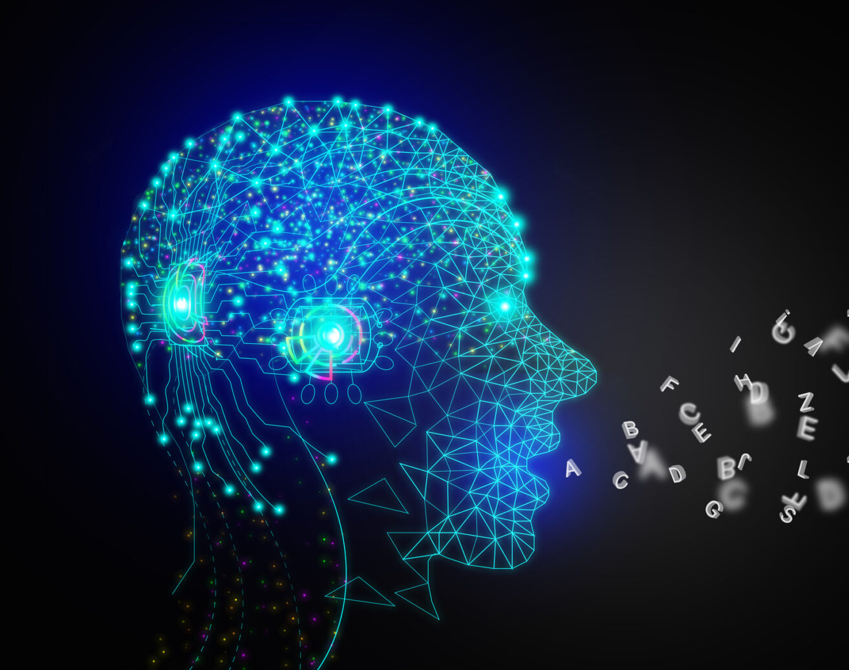
Foundation of Large Language Models
This Photo by Unknown Author is licensed under CC BY

Slide 2
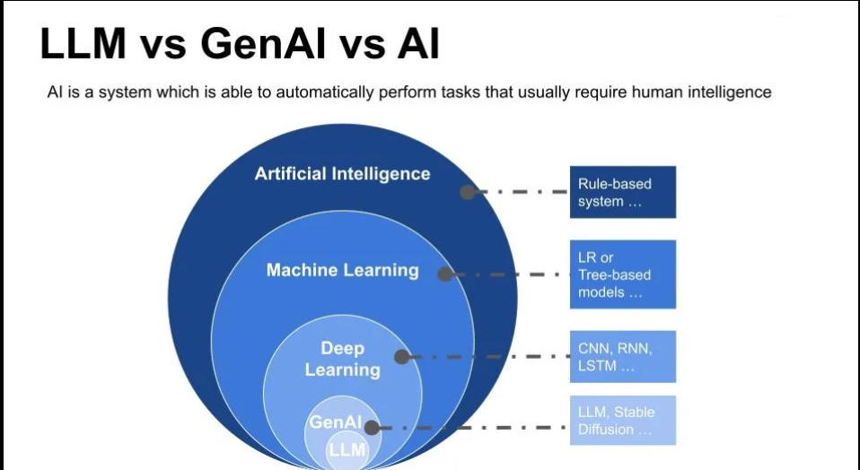

Slide 3
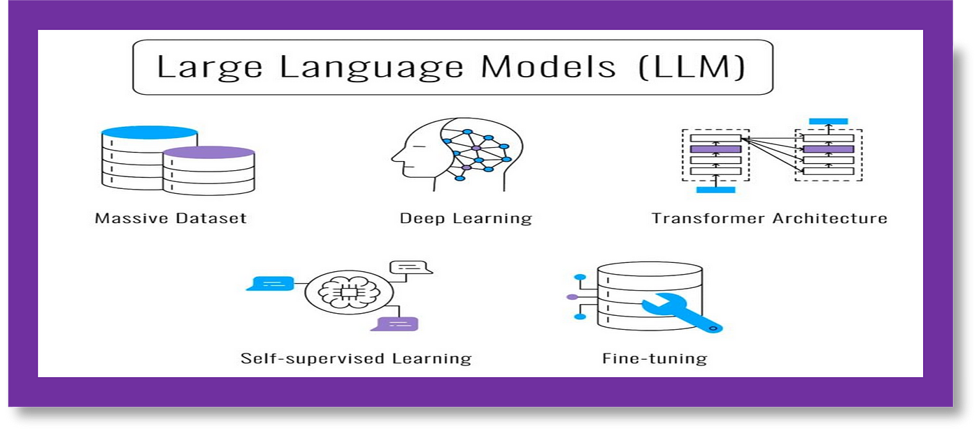
Large Language Models - Architecture

Slide 4
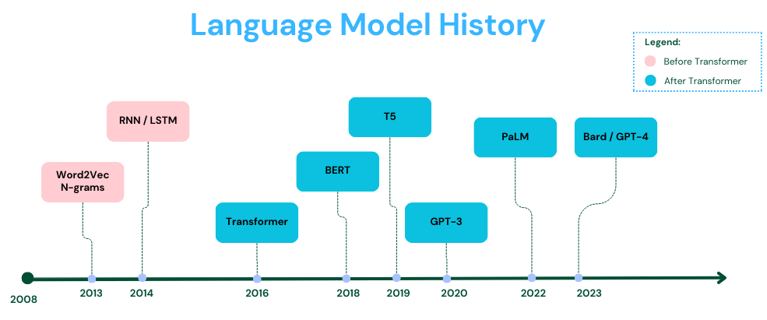

Slide 5
Transformers vs Traditional Models
RNN, LSTM, GRU
Transformers
RNNs handle sequential data by processing input sequences one element at a time.
Hidden states are updated in each time step - computationally expensive for long sequences.
LSTMs and GRUs improve on RNNs by managing memory more effectively, with LSTMs being slightly more complex.
Transformers are a type of neural network architecture that rely on self-attention mechanisms rather than recurrent connections.
Process all the elements in parallel.
Making them highly efficient for long sequences.
Notes:
Let's start by comparing traditional approaches with the revolutionary Transformer architecture:
Traditional models like RNNs, LSTMs, and GRUs have served us well, but they come with limitations:
They process data sequentially, one element at a time
They struggle with long sequences due to vanishing gradients
Updates at each time step make them computationally expensive
Enter Transformers, which revolutionized the field by:
Processing all elements in parallel
Using self-attention mechanisms instead of recurrent connections
Handling long sequences more efficiently

Slide 6
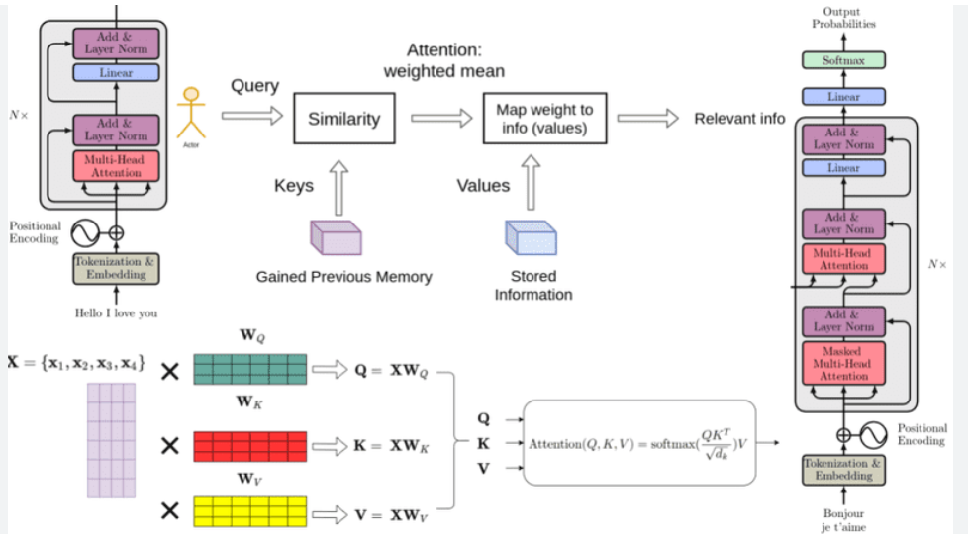
Transformer Architecture and Attention Mechanism
Notes:
transformer has 4 main parts:
Tokenization : large dataset of tokens, including all the words, punctuation signs, etc. tokenization step takes every word, prefix, suffix, and punctuation signs, and sends them to a known token from the library.
Embedding : text embeddings send every piece of text to a vector (a list) of numbers. If two pieces of text are similar, then the numbers in their corresponding vectors are similar to each other.
Positional encoding : consists of adding a sequence of predefined vectors to the embedding vectors of the words. ensures we get a unique vector for every sentence, and sentences with the same words in different order will be assigned different vectors.
Transformer block : words come in and get turned into tokens (tokenization), tokenized words are turned into numbers (embeddings), then order gets taken into account (positional encoding). This gives us a vector for every token that we input to the model. Now, the next step is to predict the next word in this sentence. This is done with a really really large neural network, which is trained precisely with that goal, to predict the next word in a sentence. key step: the attention component. -> carries the context. In multi-head attention, several different embeddings are used to modify the vectors and add context to them.
Softmax
last step of a transformer is a softmax layer, which turns these scores into probabilities (that add to 1), where the highest scores correspond to the highest probabilities. Then, we can sample out of these probabilities for the next word.

Slide 7
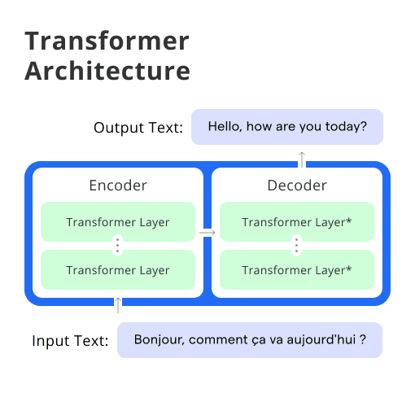
Inside the Transformer: Encoder-Decoder Architecture

Slide 8
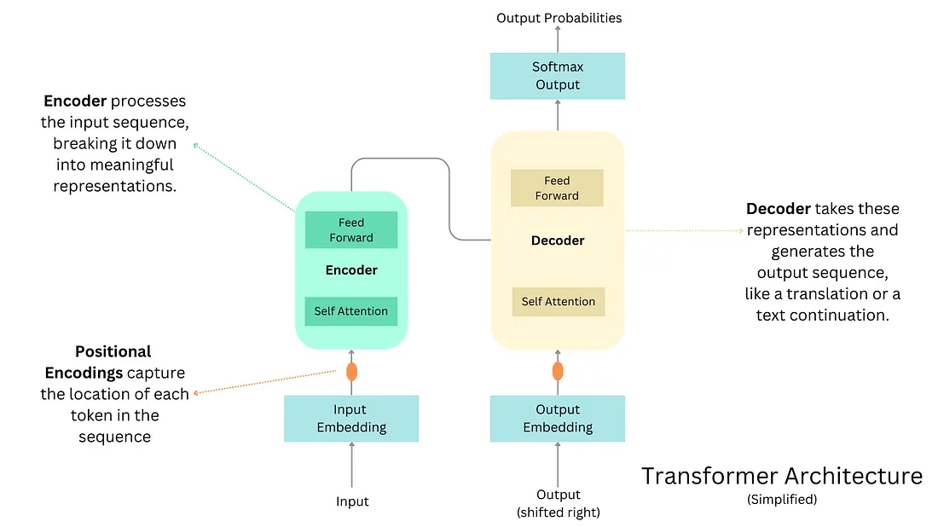
Transformer Architecture- Simplified
Notes:
A transformer accomplishes the following:
1. Pays Attention: Just like you might pay extra attention to important parts of a story, the transformer pays attention to important words in a sentence.
2. Understands Context: The transformer looks at all the words in the sentence together, not one after the other. This helps it understand how words depend on each other.
3. Weighs Relationships: It figures out how words are related to each other. For example, if the sentence is about a cat and a mouse, it knows that these words are connected.
4. Combines Insights: The transformer combines all this knowledge to understand the whole story and how words fit together.
5. Predicts Next Steps: With its understanding, it can even guess what words might come next in the story.

Slide 9
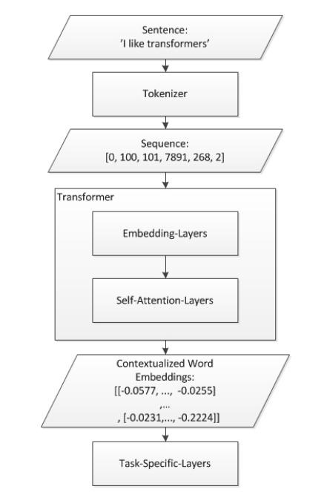
General Dataflow of transformers
The encoder receives the input, while the decoder outputs the prediction.
In an encoder-decoder schema, the encoder takes in the entirety of the input sequence. It transforms it into a vectorized representation that contains accumulated knowledge of the input sequence at every time step. Then the entire vectorized representation of the input sequence is fed into the decoder, which “decodes” the information collected by the encoder and attempts to make a valid prediction.
In the context of the Transformer model, one can make an analogy between the encoder and the decoder as a researcher developing initial ideas and discoveries. At the same time, a programmer implements a solution based on the researcher’s findings. Think of the encoder as a researcher picking out the crucial aspects of the input, such as sentence structure, syntax, and semantics. The encoder then passes on the insights learned from the inputs to the decoder. Like a programmer, the decoder will “program” a practical solution based on the insights gained by the encoder, or, in our analogy, the researcher.

Slide 10
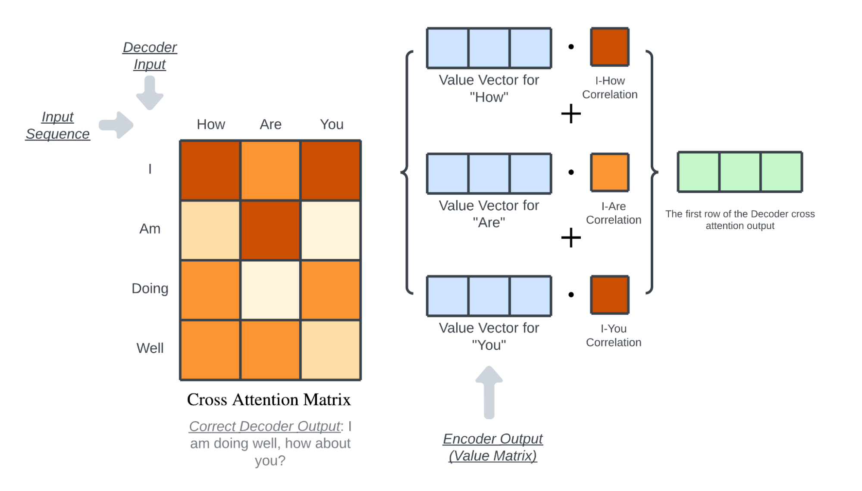

Slide 11
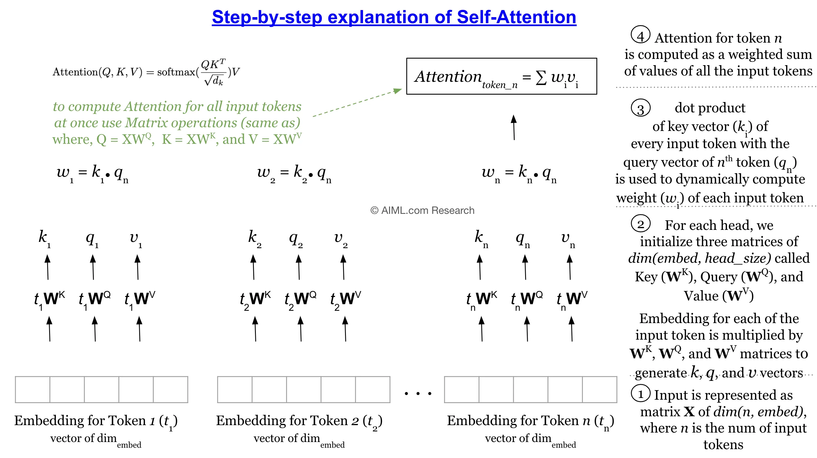

Slide 12
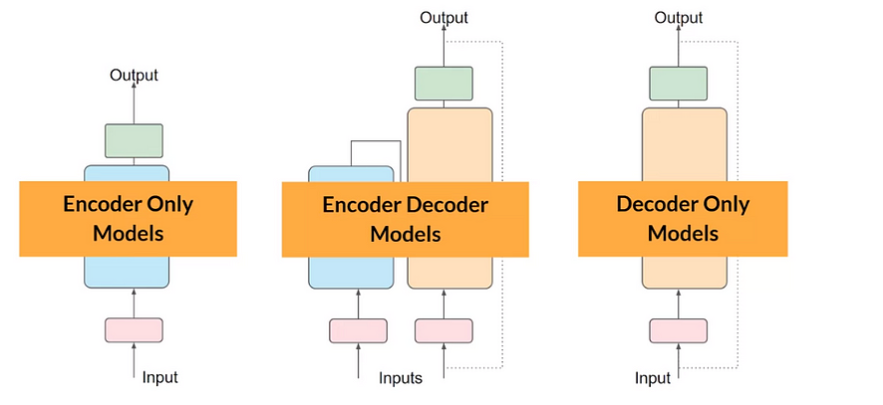
Types of Transformer Architectures

Slide 13
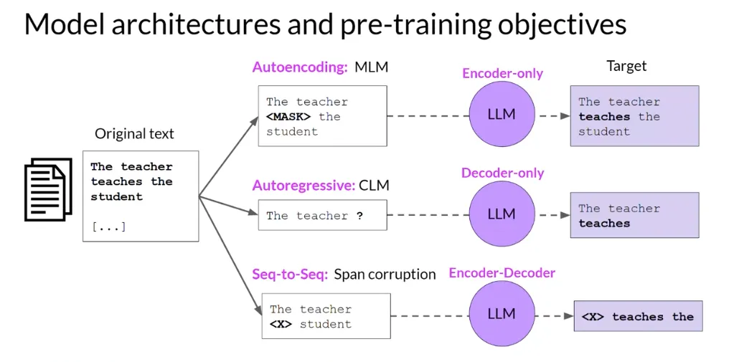
Comparison of Encoder-Only, Encoder-Decoder, and Decoder-Only Transformer Models

Slide 14
Key Techniques Used in the Pre-Training Process of LLMs depending on the usecase
Enabling your model with an expansive comprehension of language before it intercepts more precise tasks. Here are the chief methods you should know about:
Masked Language Modeling (MLM): This indulges casually masking some of the words in a sentence and instructing the model to forecast them. By doing this, your model grasps context and relation between words.
Next Sentence Prediction (NSP): This method helps you model comprehend sentence relationships. You offer a pair of sentences and instruct the model to forecast if the second sentence lucidly follows the first.
Causal Language Modeling (CLM): Here, the model is instructed to forecast the next word in a sentence based on your preliminary words. This is specifically useful for producing coherent text.
Notes:
pre-training process is crucial for developing a model's language understanding. There are three main techniques:
Masked Language Modeling (MLM):
Words in sentences are randomly masked
The model learns to predict these masked words
This builds understanding of context and relationships
Next Sentence Prediction (NSP):
Helps models understand relationships between sentences
Model predicts if sentences naturally follow each other
Causal Language Modeling (CLM):
Model predicts the next word based on previous words
Essential for generating coherent text

Slide 15


Slide 16
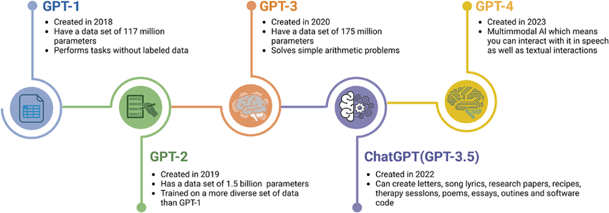

Slide 17
Pretraining stage of GPT-x
GPT-3 is trained on diverse sources including Common Crawl (filtered for quality), books, Wikipedia, and other curated texts. This mix ensures exposure to varied writing styles, domains, and factual content.
Transformer Decoder: A stack of decoder-only transformer layers with masked self-attention, enabling autoregressive token prediction (each token depends only on prior tokens).
The largest variant has 175 billion parameters, 96 layers, 12,288-dimensional embeddings, and 96 attention heads per layer. The context window spans 2,048 tokens.
Language Modeling: The core task is next-token prediction. Given a sequence of tokens, the model predicts the next token by minimizing cross-entropy loss.
Unsupervised Learning: No explicit task-specific objectives; the model learns grammar, facts, and reasoning implicitly through this objective.
Distributed Training: Combines data parallelism (split batches across devices), model parallelism (split model layers across devices), and pipeline parallelism (overlap computation and communication) to handle the model's size.
Notes:
Let's look specifically at the GPT architecture:
Trained on diverse sources including Common Crawl, books, and Wikipedia
Uses a decoder-only transformer with masked self-attention
The largest variant (GPT-3) features:
175 billion parameters
96 layers
12,288-dimensional embeddings
96 attention heads per layer
2,048 token context window

Slide 18
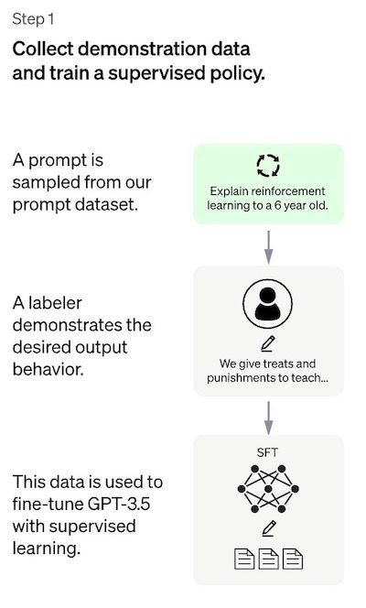
Step 1: The Supervised Fine-Tuning (SFT) model

Slide 19
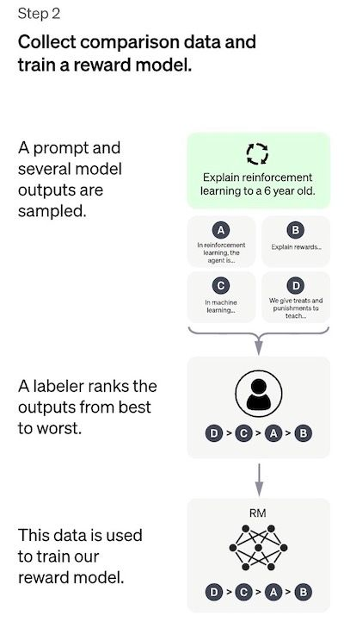
Step 2: The reward model (RM)
Goal is to learn an objective function (the reward model) directly from the data.
Purpose of this function is to give a score to the SFT model outputs, proportional to how desirable these outputs are for humans.
In the end, this process will extract from the data an automatic system that is supposed to mimic human preferences

Slide 20
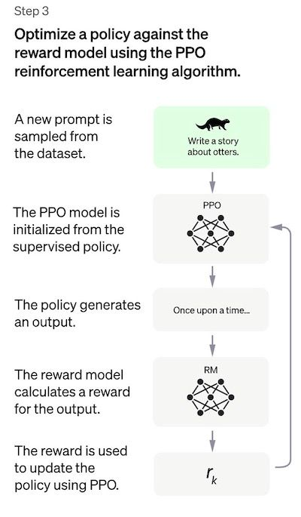
Step 3: Fine-tuning the SFT model via Proximal Policy Optimization (PPO)
Reinforcement Learning is now applied to fine-tune the SFT policy by letting it optimize the reward model using Policy Optimization (PPO)
PPO is an algorithm that is used to train agents in reinforcement learning. It is called an "on-policy" algorithm because it learns from and updates the current policy directly, rather than learning from past experiences.
This means that PPO is continuously adapting the current policy based on the actions that the agent is taking and the rewards it is receiving.
PPO uses a trust region optimization method to train the policy, which means that it constrains the change in the policy to be within a certain distance of the previous policy in order to ensure stability
PPO uses a value function to estimate the expected return of a given state or action. The value function is used to compute the advantage function, which represents the difference between the expected return and the current return.
In this step, the PPO model is initialized from the SFT model, and the value function is initialized from the reward model.
A per-token KL penalty is added from the SFT model at each token to mitigate over optimization of the reward model.

Slide 21
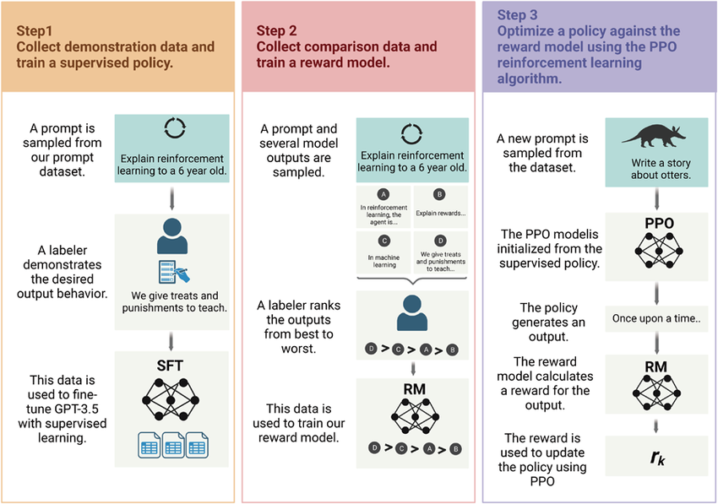
SFT and RHLF

Slide 22
Performance Evaluation
The model is evaluated on three high-level criteria:
Helpfulness: judging the model’s ability to follow user instructions, as well as infer instructions.
Truthfulness: judging the model’s tendency for hallucinations (making up facts) on closed-domain tasks. The model is evaluated on the TruthfulQA dataset.
Harmlessness: the labelers evaluate whether the model’s output is appropriate, denigrates a protected class, or contains derogatory content. The model is also benchmarked on the RealToxicityPrompts and CrowS-Pairs datasets.

Slide 23
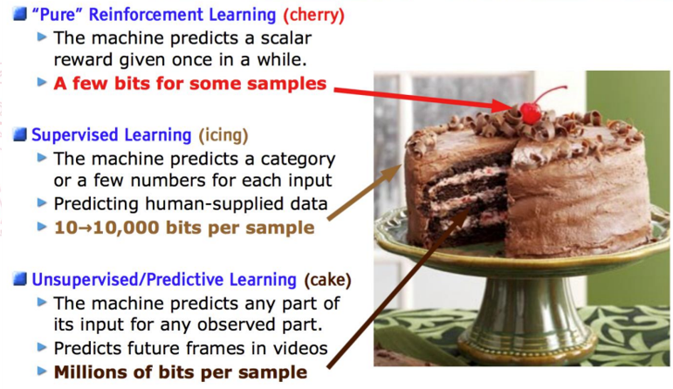
ChatGPT Training Procedure Summary
Step 1 : Pre-training on large corpus of internet data – Vanilla LLMs (GPT)
Step 2 : Supervised Training for question answer formatting
Step 3: Reinforcement Learning from Human Feedback to remove bias and toxic behavioral traits

Slide 24
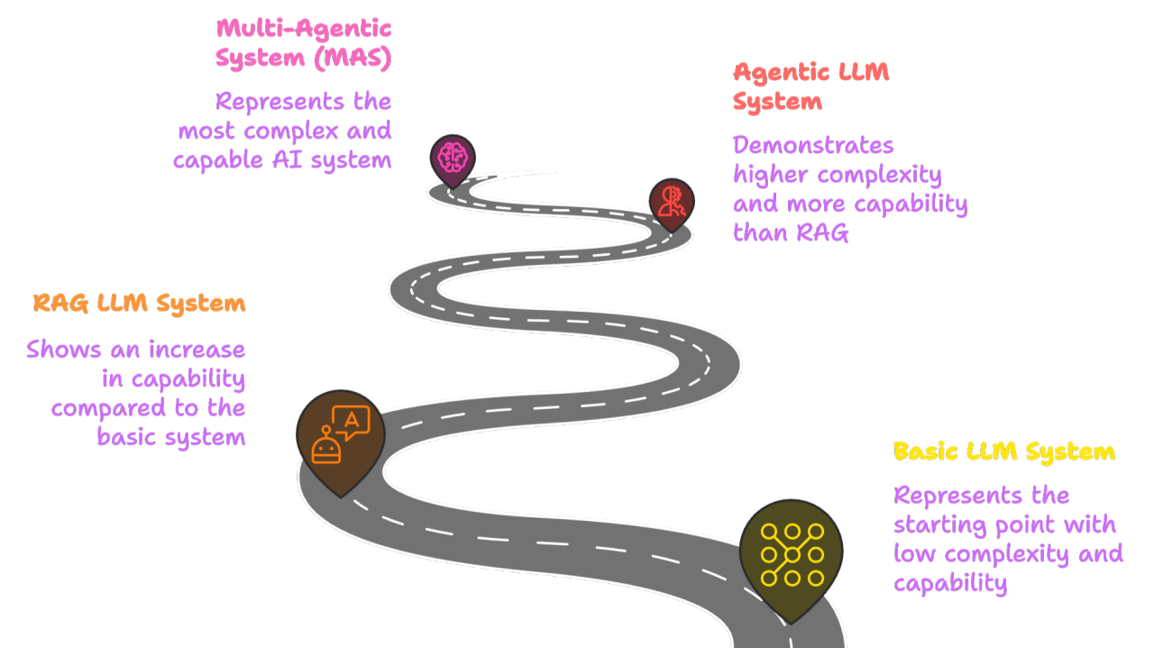
Notes:
To summarize, modern LLMs represent a fascinating convergence of:
Advanced architecture through Transformers
Sophisticated training techniques
Careful evaluation and optimization
The field continues to evolve rapidly, and understanding these foundations is crucial for anyone working with or interested in AI technology.
Thank you for your attention. Are there any questions?

Slide 25


Slide 26
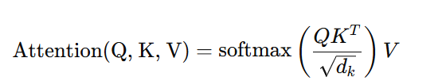
Transformer Architecture and Attention Mechanism
Core components of the Transformer architecture:
Multi-Head Attention: Computes relationships between words (queries, keys, and values) to focus on the most relevant context for each input word.
Positional Encoding: Adds sequence information to embeddings, as Transformers lack inherent order awareness.
Encoder-Decoder Structure: The encoder processes input, while the decoder generates output using masked attention for autoregression.
Mathematical Attention Formula: The attention mechanism determines relevance by computing a scaled dot-product between Q and K:
Notes:
transformer has 4 main parts:
Tokenization : large dataset of tokens, including all the words, punctuation signs, etc. tokenization step takes every word, prefix, suffix, and punctuation signs, and sends them to a known token from the library.
Embedding : text embeddings send every piece of text to a vector (a list) of numbers. If two pieces of text are similar, then the numbers in their corresponding vectors are similar to each other.
Positional encoding : consists of adding a sequence of predefined vectors to the embedding vectors of the words. ensures we get a unique vector for every sentence, and sentences with the same words in different order will be assigned different vectors.
Transformer block : words come in and get turned into tokens (tokenization), tokenized words are turned into numbers (embeddings), then order gets taken into account (positional encoding). This gives us a vector for every token that we input to the model. Now, the next step is to predict the next word in this sentence. This is done with a really really large neural network, which is trained precisely with that goal, to predict the next word in a sentence. key step: the attention component. -> carries the context. In multi-head attention, several different embeddings are used to modify the vectors and add context to them.
Softmax
last step of a transformer is a softmax layer, which turns these scores into probabilities (that add to 1), where the highest scores correspond to the highest probabilities. Then, we can sample out of these probabilities for the next word.

